Slide 1
TITANIC SURVIVAL
PREDICTION
A comparative machine learning study using passenger data
SRIJITH R | 24MID0009
Under guidance of : Dr. DURGESH KUMAR | Assistant Professor Sr. Grade 1
Vellore Institute of Technology, Vellore
FINAL TITANIC SURVIVAL PREDICTION PPT
TITANIC SURVIVAL PrEDICTION | VIT VELLORE
01 / 15

Slide 2
Project Overview
INTRODUCTION
Problem
Approach
Deliverable
Predict whether a passenger survived the Titanic disaster using passenger attributes.
Prepare the dataset, engineer features, train three classifiers, and compare validation metrics.
A reproducible machine learning workflow and survival predictions for 418 test records.
Project objective
• Build a supervised binary classification pipeline for the target variable Survived.
• Compare Logistic Regression, Decision Tree, and Random Forest under the same validation split.
• Select a model using F1-score and generate predictions for the separate test dataset.
TITANIC SURVIVAL PREDICTION | VIT VELLORE
02 / 15

Slide 3
Problem Statement and Objectives
PROBLEM DEFINITION
Problem statement
Specific objectives
The task is to learn patterns from labelled Titanic passenger records and predict the binary survival outcome for unseen passenger records.
• Inspect data quality and identify missing values.
• Prepare numerical and categorical variables consistently.
• Derive family-related features from passenger counts.
• Evaluate models using accuracy, precision, recall, and F1-score.
• Generate a prediction file for the 418 test passengers.
Target variable: Survived
0 = did not survive | 1 = survived
TITANIC SURVIVAL PREDICTION | VIT VELLORE
03 / 15

Slide 4
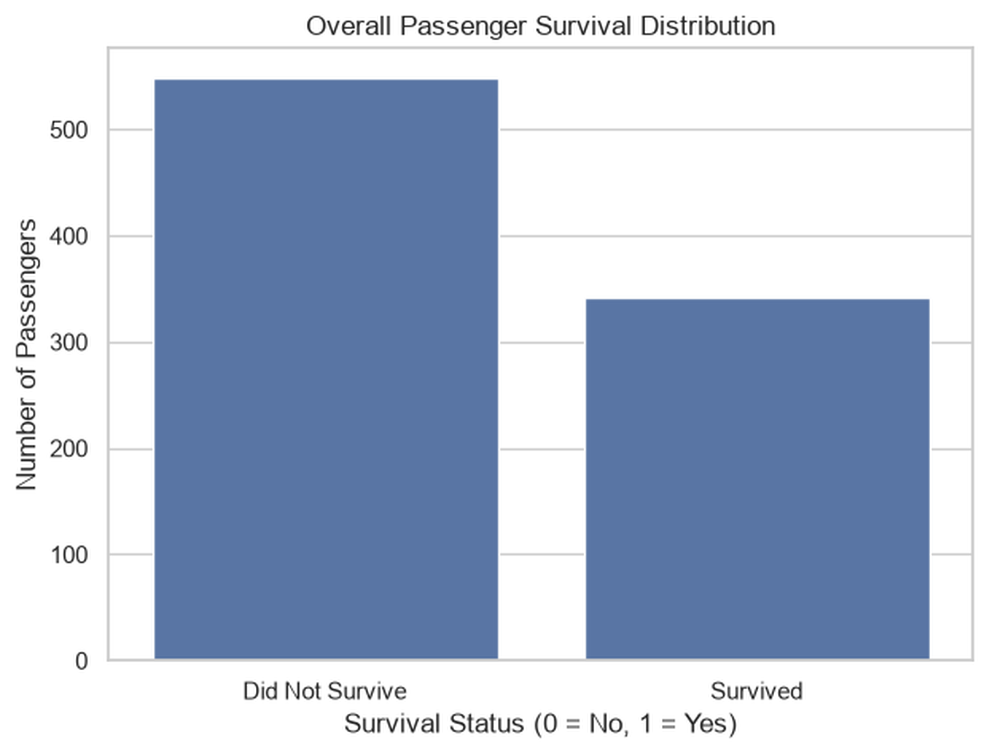
Dataset Description
DATA
Training set
Test set
Target distribution
891 rows × 12 columns
Includes the labelled target variable.
418 rows × 11 columns
Used for final prediction only.
549 non-survivors
342 survivors
Selected input features
• Pclass and Sex
• Age and Fare
• SibSp and Parch
• Embarked
TITANIC SURVIVAL PREDICTION | VIT VELLORE
04 / 15

Slide 5
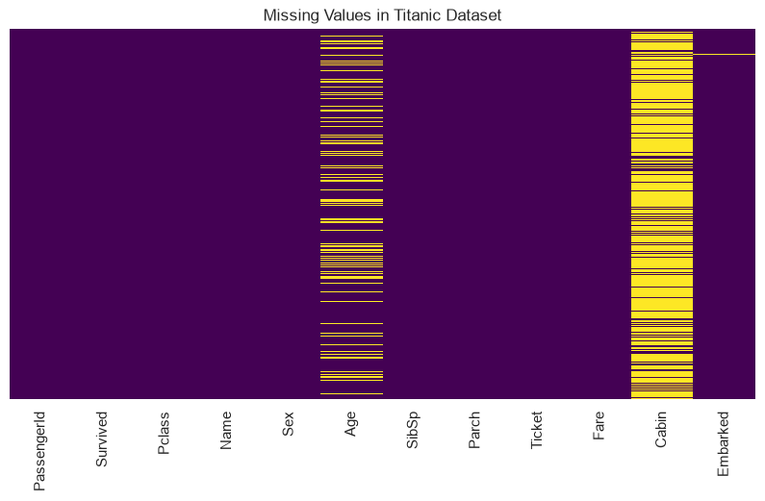
Exploratory Data Analysis: Data Quality
EDA
Key observations
• Age: 177 missing values (19.87%).
• Cabin: 687 missing values (77.10%).
• Embarked: 2 missing values (0.22%).
• Cabin was excluded from the selected model features; Age and Embarked were imputed.
Missing-value treatment is fitted within the preprocessing pipeline to avoid fitting transformations on the validation data.
TITANIC SURVIVAL PREDICTION | VIT VELLORE
05 / 15

Slide 6
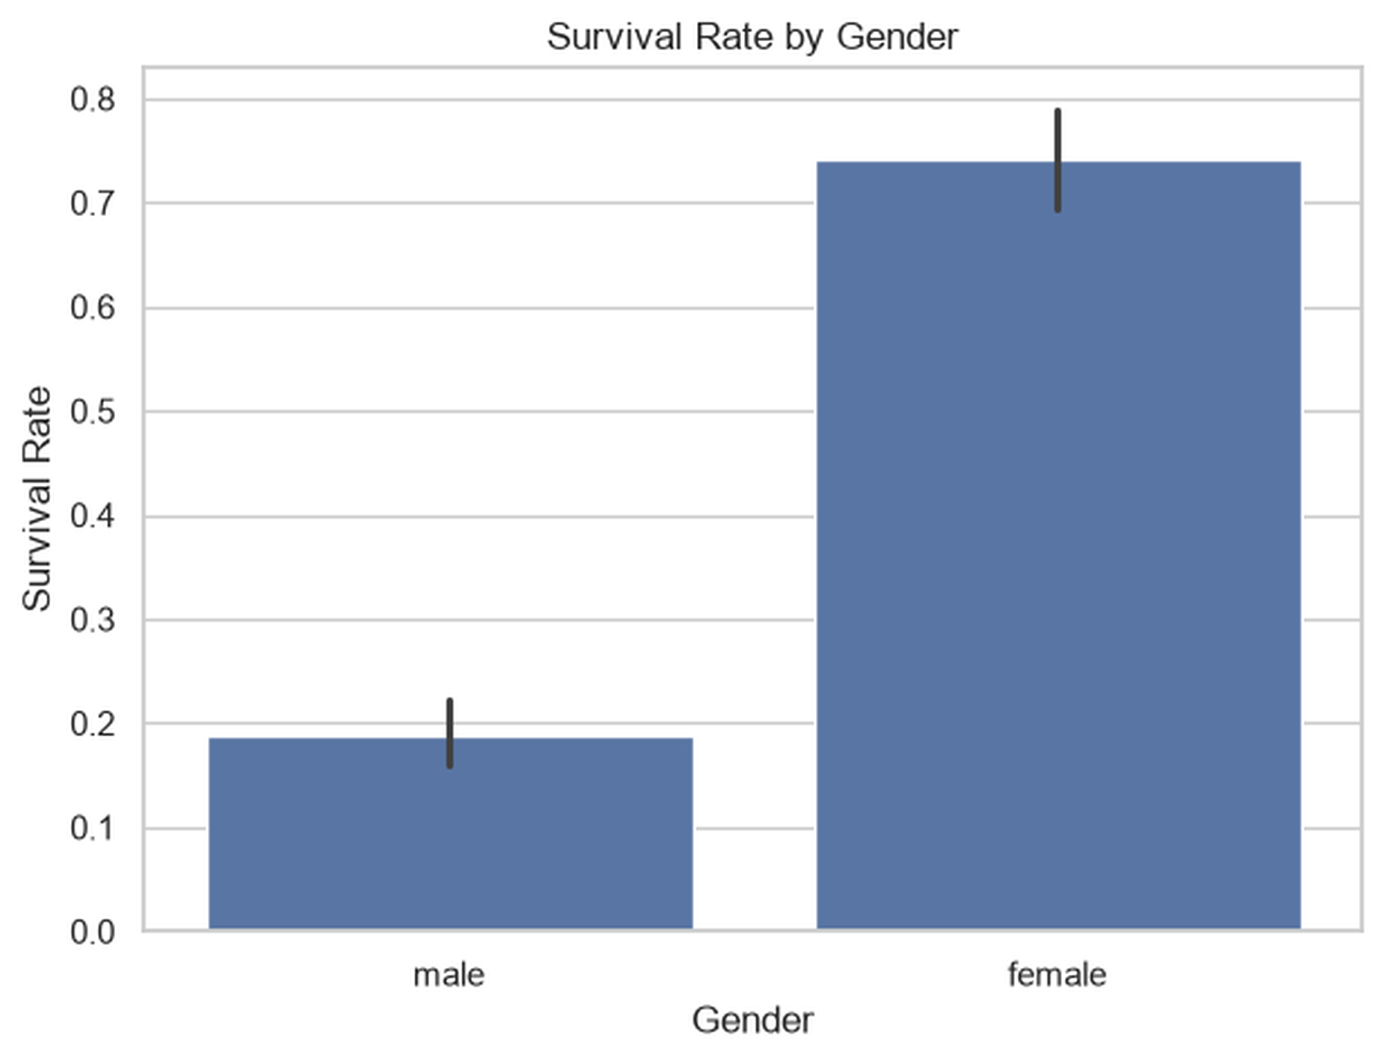
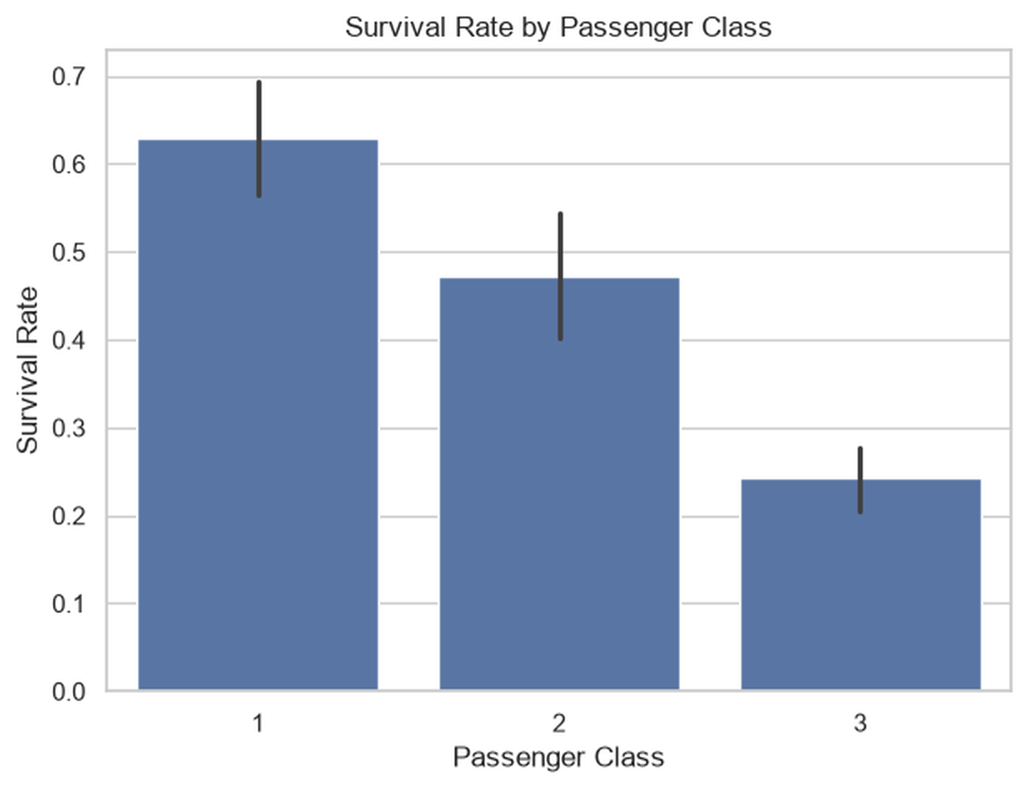
Exploratory Data Analysis: Survival Patterns
EDA
Gender
Passenger class
Female survival rate ≈ 0.74; male survival rate ≈ 0.19.
Observed survival rate: 1st ≈ 0.63, 2nd ≈ 0.47, 3rd ≈ 0.24.
TITANIC SURVIVAL PREDICTION | VIT VELLORE
06 / 15

Slide 7
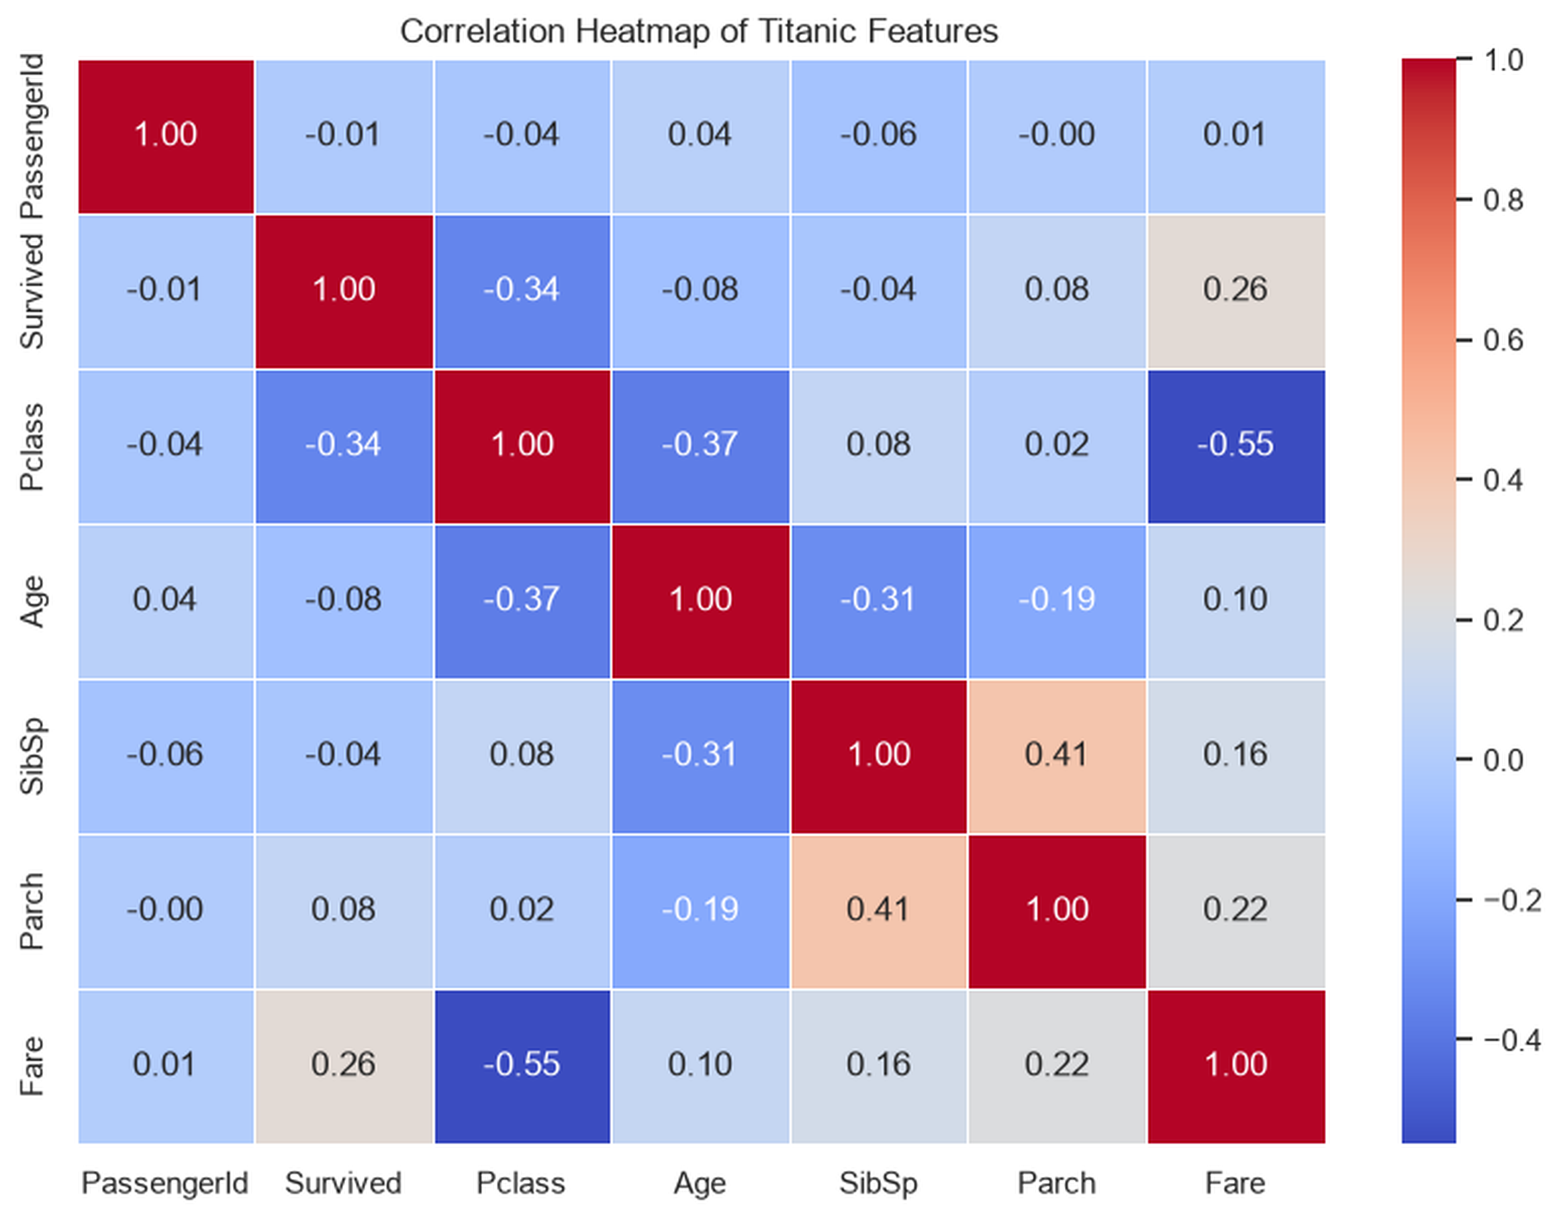
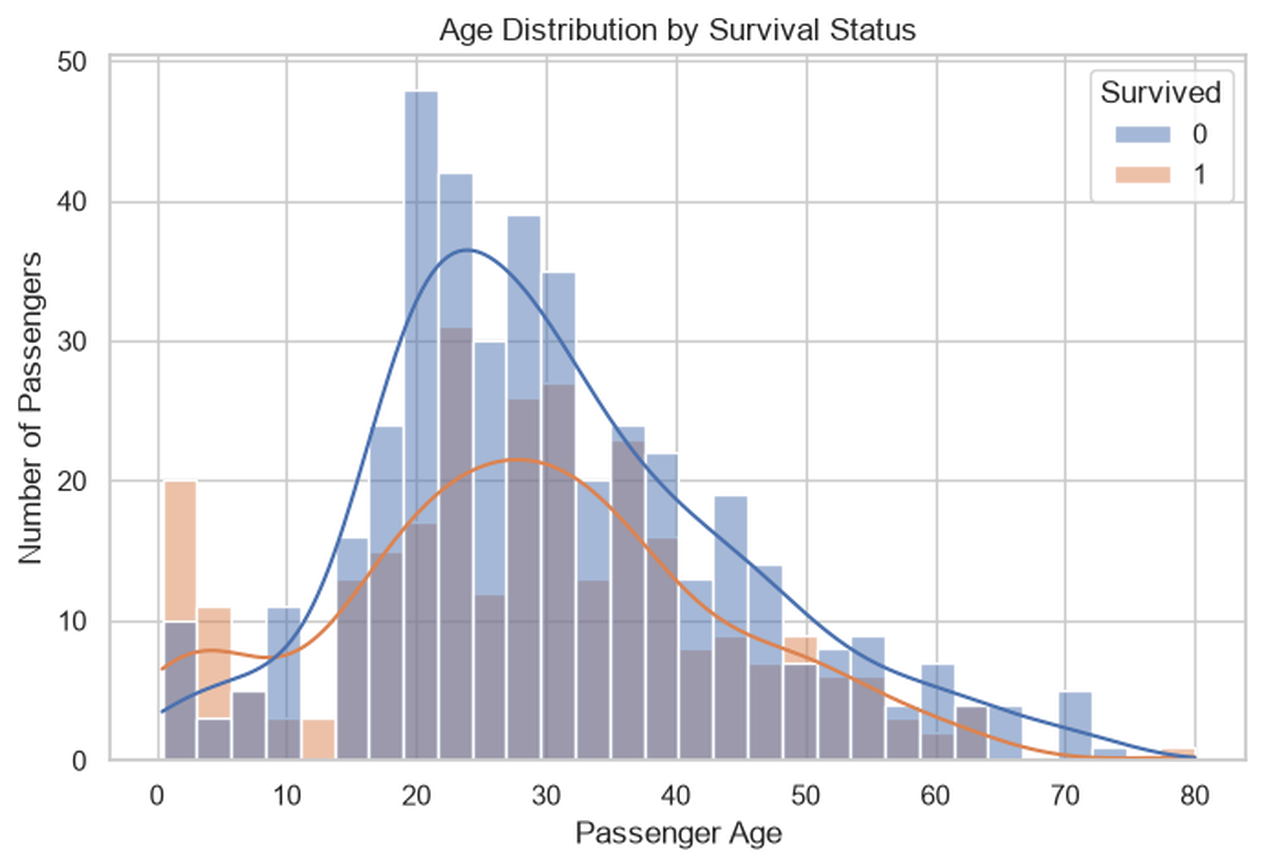
Exploratory Data Analysis: Age and Correlation
EDA
Age distributions overlap across survival classes; Age alone is not sufficient to distinguish outcomes.
Notable associations: Pclass–Fare ≈ −0.55; SibSp–Parch ≈ 0.41; Survived–Pclass ≈ −0.34.
TITANIC SURVIVAL PREDICTION | VIT VELLORE
07 / 15

Slide 8
Feature Engineering
METHODOLOGY
FamilySize
IsAlone
FamilySize = SibSp + Parch + 1
Captures the total number of family members travelling with a passenger, including the passenger.
IsAlone = 1 if FamilySize = 1; otherwise 0
Indicates whether a passenger travelled without listed family members.
Feature groups supplied to the model
Numerical features | Categorical features
Pclass, Age, SibSp, Parch | Sex, Embarked
Fare, FamilySize, IsAlone | One-hot encoded
TITANIC SURVIVAL PREDICTION | VIT VELLORE
08 / 15

Slide 9
Preprocessing Pipeline
METHODOLOGY
Firstly collect Raw features
Missing values
Transform
Classifier
May be bth Numerical + categorical
→
Replace it wit Median / most frequent
→
Eiehter by using StandardScaler / OneHotEncoder
→
Logistic / Tree / Forest
Implementation details
• Numerical pipeline: median imputation followed by standardization.
• Categorical pipeline: most-frequent imputation followed by OneHotEncoder(handle_unknown='ignore').
• ColumnTransformer and Pipeline keep preprocessing and model fitting together.
TITANIC SURVIVAL PREDICTION | VIT VELLORE
09 / 15

Slide 10
Training Strategy and Classifiers
METHODOLOGY
Training subset
Validation subset
Split configuration
712 records
439 class 0 | 273 class 1
179 records
110 class 0 | 69 class 1
80:20 stratified split
random_state = 42
Classifier | Configuration
Logistic Regression | max_iter = 1000
Decision Tree | max_depth = 5; random_state = 42
Random Forest | 200 estimators; max_depth = 6; random_state = 42
TITANIC SURVIVAL PREDICTION | VIT VELLORE
10 / 15

Slide 11
Evaluation Metrics
EVALUATION
Metric | Definition | Interpretation
Accuracy | (TP + TN) / (TP + TN + FP + FN) | Overall fraction of correct predictions
Precision | TP / (TP + FP) | Reliability of positive predictions
Recall | TP / (TP + FN) | Fraction of actual positives identified
F1-score | 2 × (Precision × Recall) / (Precision + Recall) | Harmonic mean of precision and recall
Model selection criterion
The model with the highest validation F1-score was selected for final prediction.
TITANIC SURVIVAL PREDICTION | VIT VELLORE
11 / 15

Slide 12
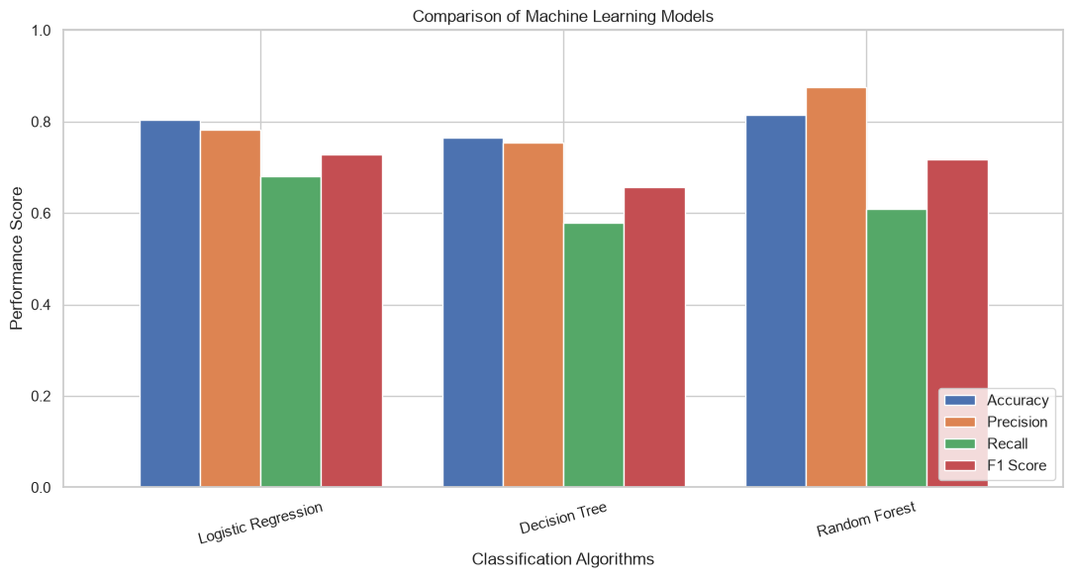
Validation Results: Model Comparison
RESULTS
Model | Accuracy | Precision | Recall | F1
Logistic Regression | 0.8045 | 0.7833 | 0.6812 | 0.7287
Decision Tree | 0.7654 | 0.7547 | 0.5797 | 0.6557
Random Forest | 0.8156 | 0.8750 | 0.6087 | 0.7179
Interpretation
• Random Forest: highest accuracy and precision.
• Logistic Regression: highest recall and F1-score.
• Decision Tree: lowest accuracy and F1-score.
TITANIC SURVIVAL PREDICTION | VIT VELLORE
12 / 15

Slide 13
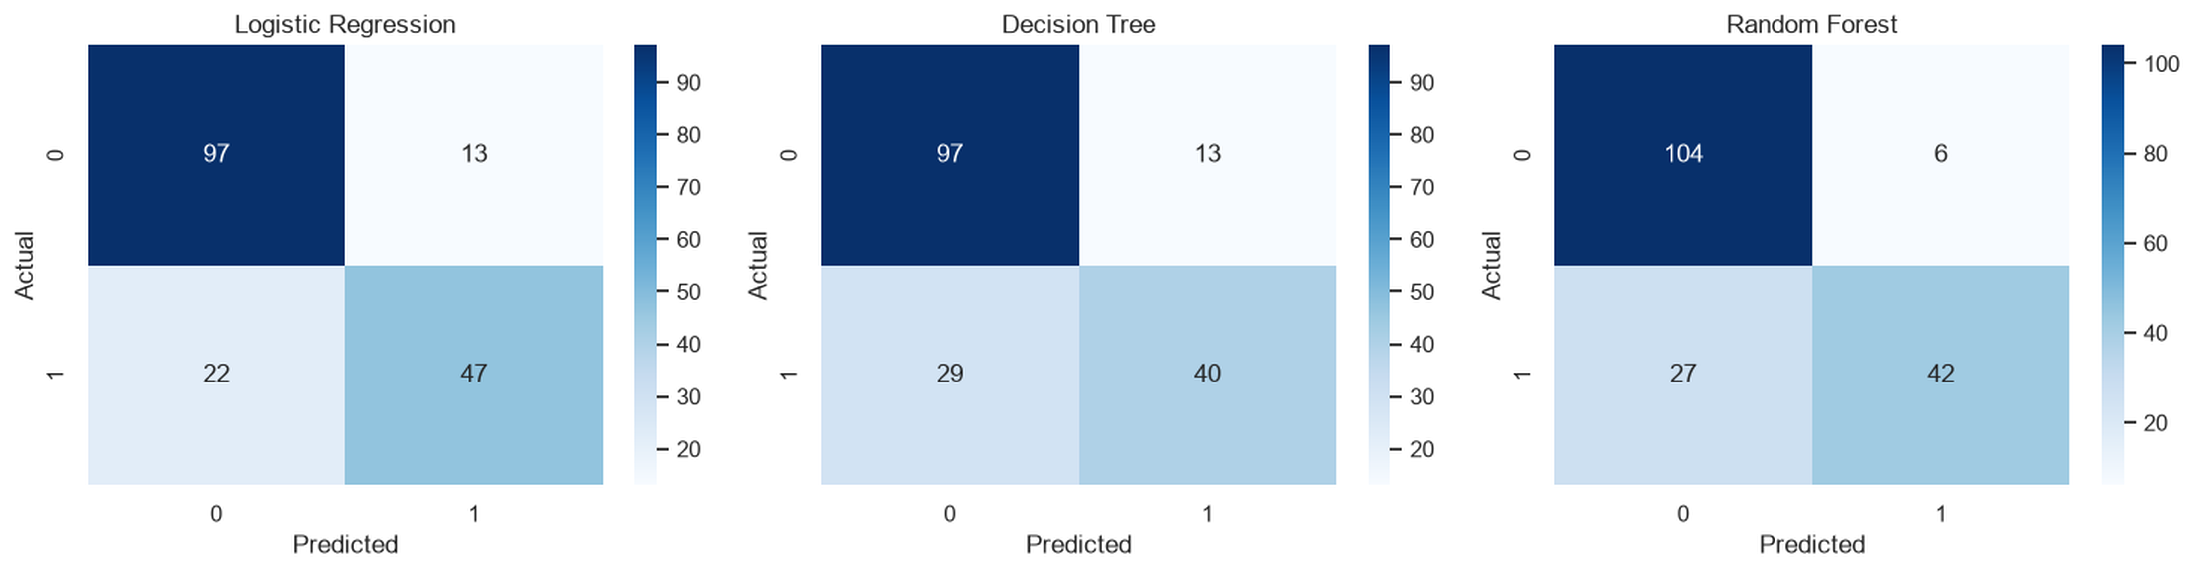
Validation Results: Confusion Matrices
RESULTS
Validation counts
Model | TN | FP | FN | TP
Logistic Reg. | 97 | 13 | 22 | 47
Decision Tree | 97 | 13 | 29 | 40
Random Forest | 104 | 6 | 27 | 42
Logistic Regression identifies the largest number of actual survivors (47). Random Forest produces the fewest false positives (6).
TITANIC SURVIVAL PREDICTION | VIT VELLORE
13 / 15

Slide 14
Final Model and Prediction Output
OUTPUT
Selected model
Final training
Test predictions
Logistic Regression
Highest validation F1-score: 0.7287
Selected pipeline refitted on all 891 labelled training records.
418 predictions generated and saved as titanic_submission.csv.
Prediction class distribution
Output file
Predicted class | Count | Share
0 – Did not survive | 259 | 61.96%
1 – Survived | 159 | 38.04%
Total | 418 | 100%
outputs/titanic_submission.csv
Contains PassengerId and predicted Survived values for the 418 test records.
TITANIC SURVIVAL PREDICTION | VIT VELLORE
14 / 15

Slide 15
Conclusion, Limitations and Future Work
CONCLUSION
Conclusion
Limitations
Future Work
Three classification algorithms were evaluated using a common preprocessing and validation strategy. Logistic Regression was selected because it achieved the highest F1-score (0.7287). The selected pipeline generated predictions for all 418 test records.
Evaluation is based on one stratified 80:20 split. Hyperparameters were predefined rather than exhaustively tuned. Missing data and the limited feature set may affect predictive performance. External validation was not performed.
Apply repeated stratified cross-validation, perform systematic hyperparameter tuning, investigate additional feature engineering, and validate the approach on independent labelled data.
Thank you
TITANIC SURVIVAL PREDICTION | VIT VELLORE
15 / 15

